Slide 1
Introduction to Big Data and Data Analytics
Chapter 5

Slide 2
Key Concepts:
1. Introduction to Big Data
2. Types of Big Data
3. Advantages and Disadvantages of Big Data
4. Characteristics of Big Data
5. Big Data Analytics
6. Working on Big Data Analytics
7. Mining Data Streams
8. Future of Big Data Analytics

Slide 3
5.1. What is Small Data?
Datasets that are easily comprehendible by people
Easily accessible, informative, and actionable.
Ideal for individuals and businesses to find useful information and make better choices in everyday tasks.
For example, a small store might track daily sales to decide what products to restock.

Slide 4
5.1. What is Big Data?
Extremely large and complex datasets that regular computer programs and databases cannot handle.
It comes from three main sources:
transactional data (e.g., online purchases)
machine data (e.g., sensor readings)
social data (e.g., social media posts)
Special tools and techniques are required.
Help organizations find valuable insights hidden in the data, which lead to innovations and better decision-making.
For example, companies like Amazon and Netflix use Big Data to recommend products or shows based on users’ past activities.

Slide 5
Sources of Big Data

Slide 6
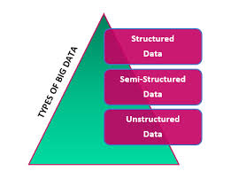
5.2. Types of Big Data

Slide 7
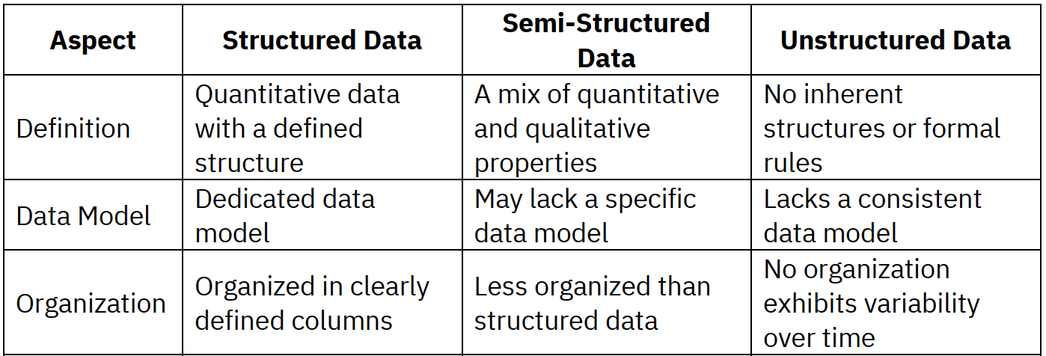

Slide 8
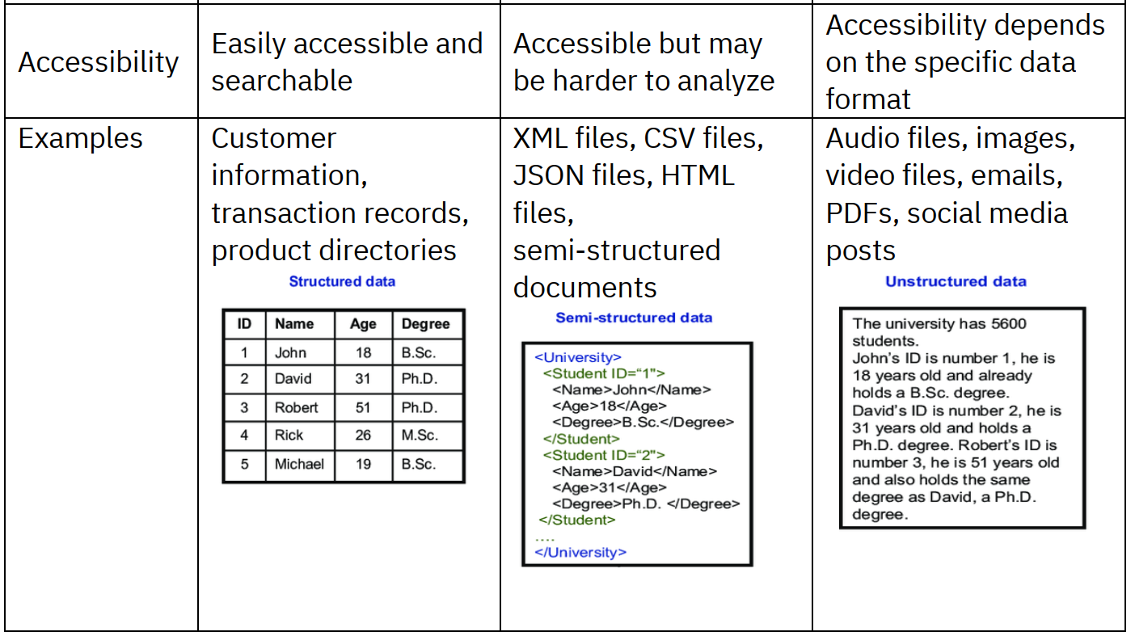

Slide 9
Advantages of Big Data
Improved Efficiency & Productivity
Better Customer Insights
Enhanced Decision
Making
Deeper understanding of behavior, preferences, and needs.
Data-driven decisions from large, diverse datasets.
Identify inefficiencies, streamline processes, optimize resources.
Competitive Advantage
Innovation & Growth
Uncover market trends, identify opportunities, stay ahead.
Develop new products, services, and
business models.

Slide 10
Disadvantages of Big Data
Privacy & Security Concerns
Data Quality Issues
Technical Complexity
Challenges in ensuring accuracy, reliability, and completeness.
Requires specialized skills and expertise for infrastructure and tools.
Risks of unauthorized access, breaches, and misuse of personal info.
Regulatory Compliance
Cost & Resource Intensiveness
Challenges in meeting data protection laws
like GDPR.
High costs for acquisition, storage, processing, and skilled staff.

Slide 11


Characteristics of Big Data: The 6Vs
Velocity
Volume
Speed of data generation, delivery, and analysis (e.g., 40,000 Google searches/sec).
Huge amount of data generated daily, typically exceeding gigabytes (e.g., 328.77 million TB/day).
Variety
Veracity
Data in various formats: structured, unstructured, semi-structured (text, images, audio, video).
Consistency, accuracy, quality, and trustworthiness of data; requires cleaning.
Value
Variability
Business value derived from data analysis; critical for insights.
Regularity and dependability of data stream structure despite unpredictability.

Slide 12
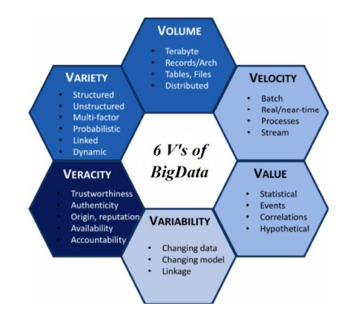
5.3. Advantages and Disadvantages of Big Data:

Slide 13
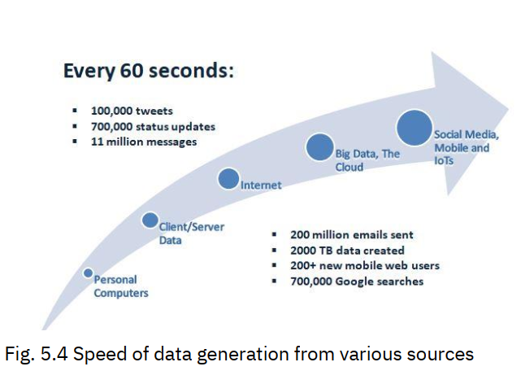
Velocity
Velocity refers to the speed at which data is generated, delivered, and analyzed.

Slide 14
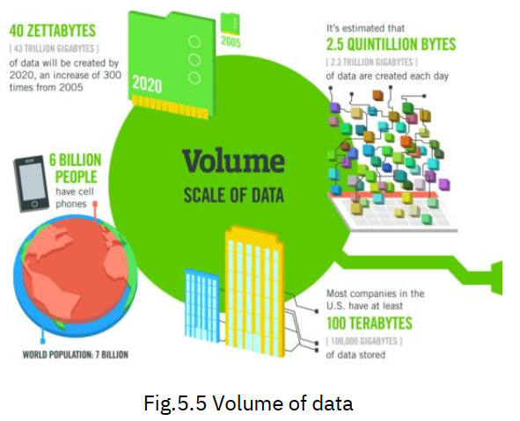
Volume
Every day a huge volume of data is generated as the number of people using online platforms has increased exponentially. Such a huge volume of data is considered Big Data.

Slide 15
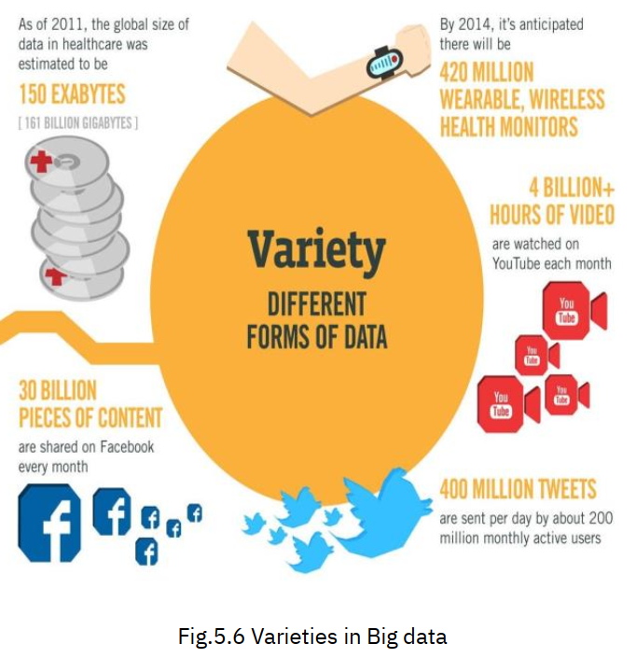
Variety
Big data encompasses data in various formats, including structured, unstructured, semi-structured, or highly complex structured data.
These can range from simple numerical data to complex and diverse forms such as text, images, audio, videos, and so on.

Slide 16
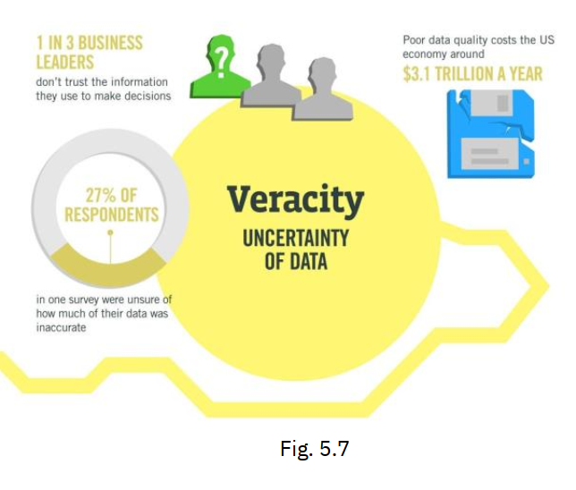
Veracity
Veracity is a characteristic in Big Data related to consistency, accuracy, quality, and trustworthiness.
Not all data that undergoes processing holds value.

Slide 17
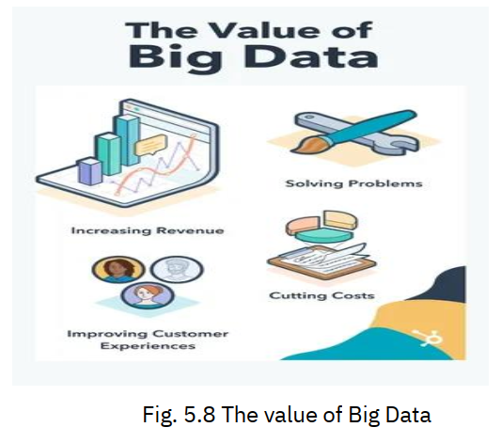
Value
The goal of big data analysis lies in extracting business value from the data.
Hence, the business value derived from big data is perhaps its most critical characteristic.

Slide 18
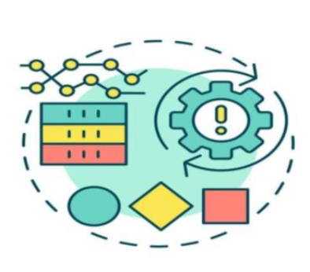
Variability
This refers to establishing if the contextualizing structure of the data stream is regular and dependable even in conditions of extreme unpredictability.

Slide 19
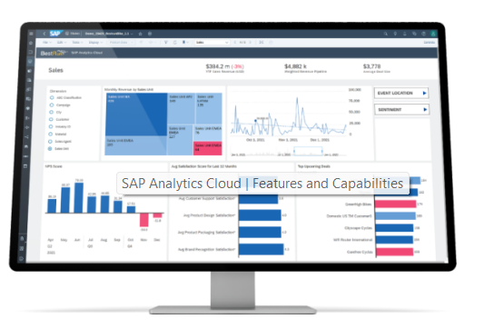
Big Data Analytics
Involves analyzing datasets to uncover insights, trends, and patterns.
Technologies commonly used in data analytics include statistical analysis software, data visualization tools, and relational database management systems (RDBMS).

Slide 20
Big Data Analytics
Big data analytics uses advanced analytic techniques against huge, diverse datasets that include
structured,
semi-structured, and
unstructured data,
from different sources, and
in various sizes from terabytes to zettabytes.

Slide 21
Big Data Analytics
Big-Data Analytics encompasses the methodologies, tools, and practices involved in analyzing and managing data, covering tasks such as data collection, organization, and storage.
The primary objective of data analytics is to utilize statistical analysis and technological methods to uncover patterns and address challenges.
It provides valuable insights and forecasts that help businesses make informed decisions to improve their operations and outcomes.

Slide 22
Big Data Analytics
Some of the common types are:
Descriptive analytics,
Diagnostic analytics,
Predictive analytics, and
Prescriptive analytics

Slide 23

Global Trends of Big Data
Moore’s Law:
Mobile Computing:
The exponential growth of computing power as per Moore's Law has enabled the handling and analysis of massive datasets, driving the evolution of Big
Data Analytics.
With the widespread adoption of smartphones and mobile devices, access to vast amounts of data is now at our fingertips, enabling real-time connectivity and data collection from anywhere.
Social Networking:
Cloud Computing:
Platforms such as Facebook, Foursquare, and Pinterest facilitate extensive networks of user-generated content, interactions, and data sharing, leading to the generation of massive datasets ripe for analysis.
This paradigm shift in technology infrastructure allows organizations to access hardware and software resources remotely via the Internet on a pay-as-you-go basis, eliminating the need for extensive on-premises hardware and software investments.

Slide 24
Working on Big Data Analytics
2. Process Data
1. Gather Data
Prepare data for accurate results using batch or stream processing.
Collect structured and unstructured data from diverse sources like cloud, mobile apps, IoT sensors.
4. Analyze Data
3. Clean Data
Turn cleaned data into insights using advanced analytics processes.
Improve data quality by correcting formatting and eliminating duplicates/irrelevant entries.
Tools: Tableau, Apache Hadoop, Cassandra, MongoDB, SAS.

Slide 25
Using Orange Data Mining for Big Data Analytics

Slide 26

Mining Data Streams
What is a Data Stream?
What is Mining Data Streams?
A continuous, real-time flow of data from sources like sensors, satellite images, and web traffic.
Extracting patterns and knowledge from real-time data flows without complete storage. Example: Analyzing website traffic spikes for election results.

Slide 27
Future of Big Data Analytics
Real-Time Analytics
Advanced Predictive Models
Quantum Computing
Instantaneous data processing for immediate insights and actions.
Revolutionary processing power to solve complex problems faster.
Integration of sophisticated ML/AI for precise trend forecasting.

